Slide 1
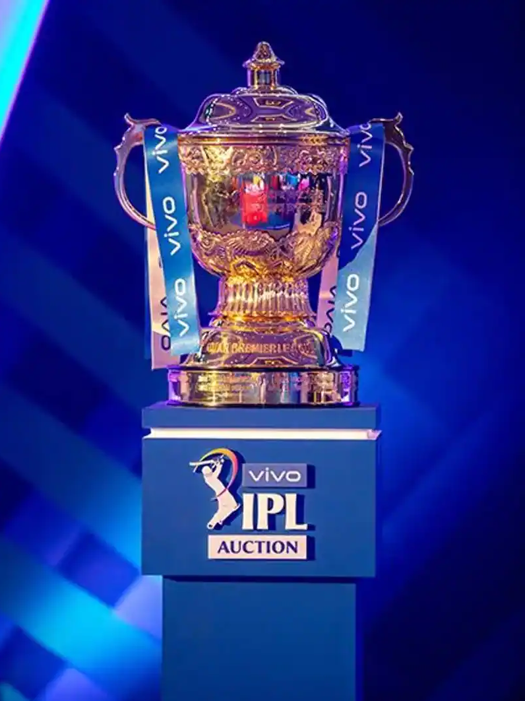
IPL Visualization Assignment
Tableau Assignment
Anishma Kathpal
+91 70839 82723
anishmakathpal1503@gmail.com

Slide 2
Contents
IPL Visualization Assignment
Contents
Problem Statement
Dashboard 1: Match Statistics
Toss outcome vs Match outcome (for each Ground/Venue)
Biggest wins (by runs and by wicket)
Highest totals (across all the seasons)
Dashboard 2: Player Statistics
Orange Cap contenders (The batsmen who have scored the maximum number of runs in a particular season)
Purple Cap contenders (The bowlers who have taken the maximum number of wickets in a particular season)
Batsmen who have hit the most number of fours and sixes (per season and overall)
Dashboard 3: Team Statistics
Season-wise team performance (wins vs losses)
Win %age ( home vs away)

Slide 3
Problem Statement
IPL Visualization Assignment
Problem Statement
You work as a data analyst at IFP, a nationally recognized news agency, which is based out of New Delhi, and provides news reports and feeds to magazines, newspapers and TV broadcasters all over the country. The Sports Editor of the agency has approached you to build a Tableau dashboard of IPL statistics over the years since its inception in order to create an infographic for a newsletter that their team is working on. For this newsletter, in some cases, they will use the visual representations as you have created in Tableau directly for their infographic, and in a few other cases, they will use important statistics after trying out the different filters and customizations that you have provided for interactivity. Therefore, you are expected to build an interactive dashboard in Tableau for this purpose.
DATA SET
matches.csv - It contains match-level information for each and every match held in IPL from 2008 to 2017.
deliveries.csv - It contains ball-by-ball information for each of the matches.
Combining the information in these two data sets, you will be creating an interactive dashboard that highlights some of the important statistics of IPL over the years.

Slide 4
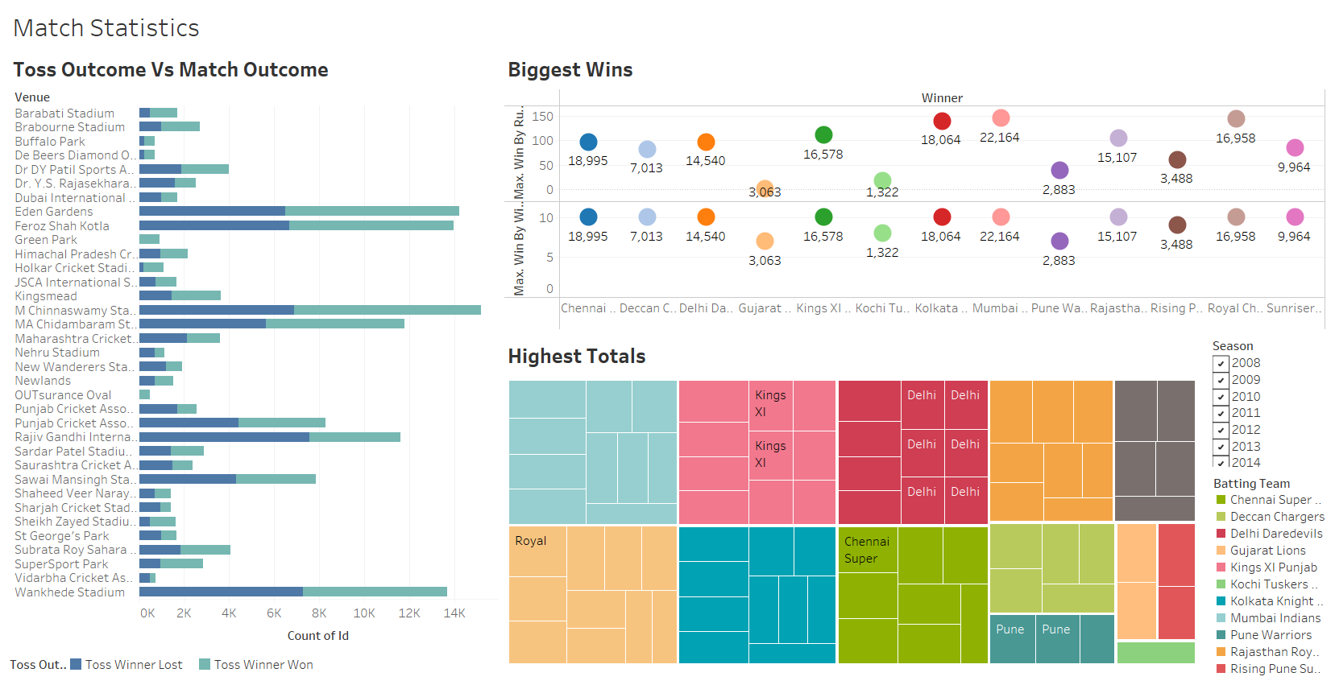
IPL Visualization Assignment
Dashboard 1 : Match Statistics

Slide 5
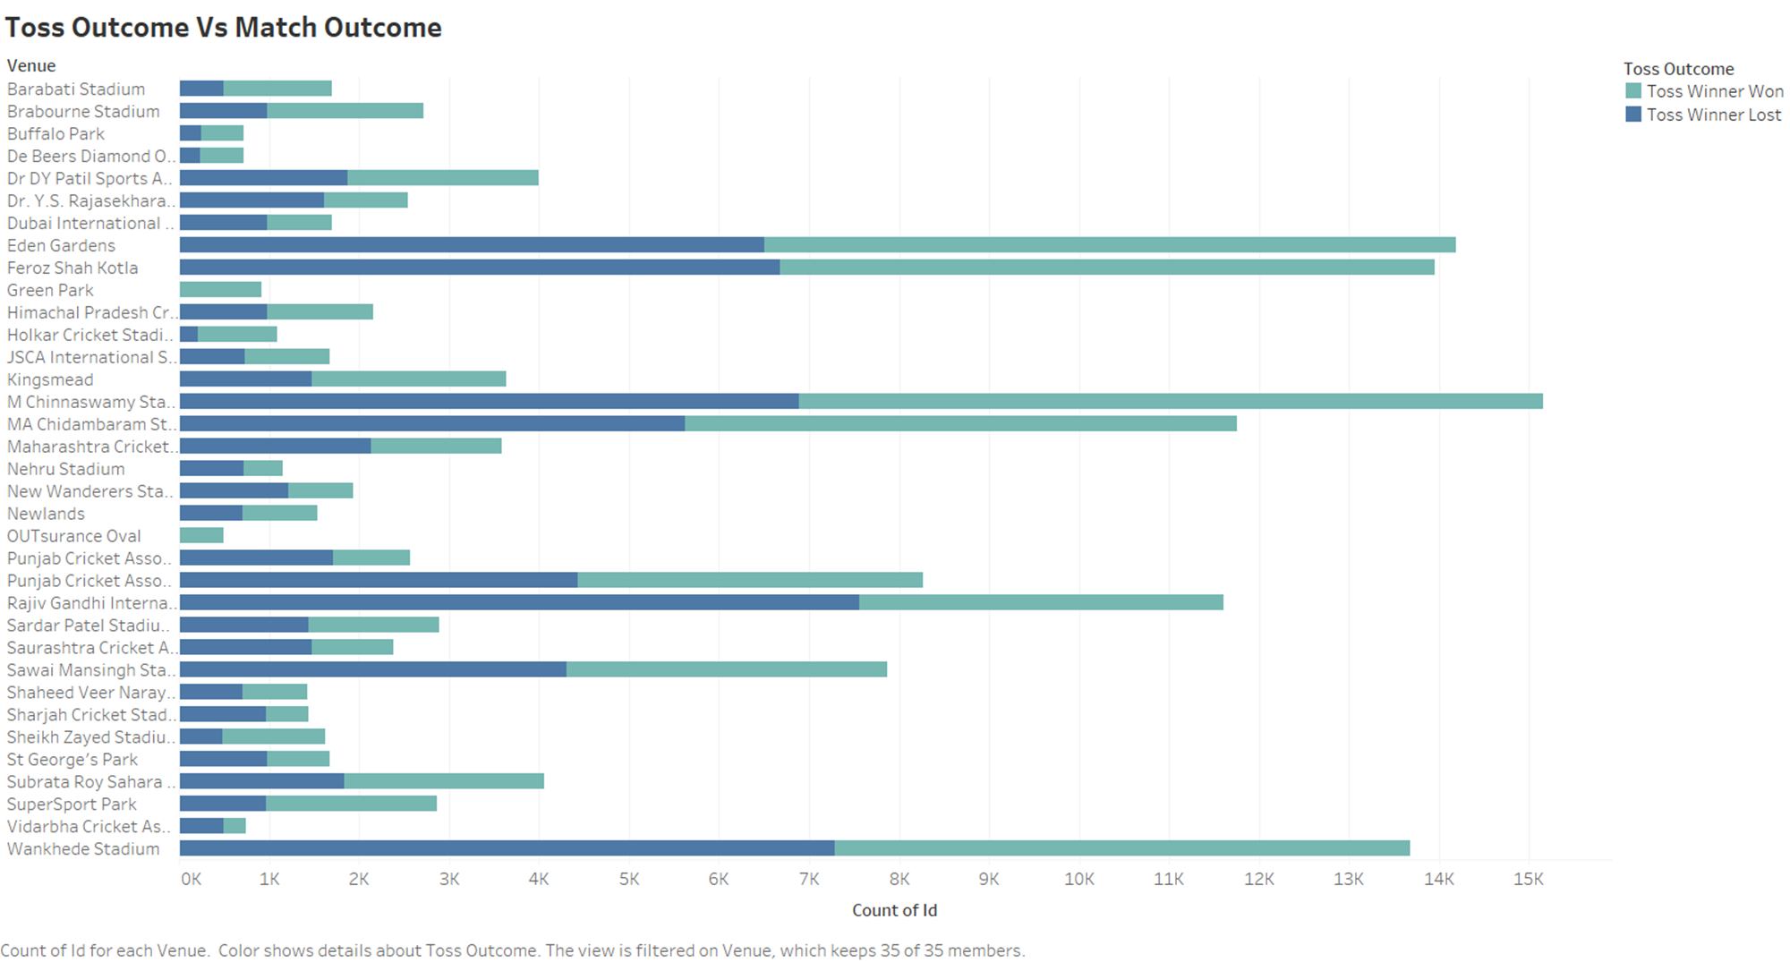
IPL Visualization Assignment
Toss Outcome Vs Match Outcome

Slide 6
IPL Visualization Assignment
Toss Outcome Vs Match Outcome
INSIGHTS
Maximum Matches(15000+) were played in M Chinnaswamy Stadium, where Maximum Matches(8200+) where the team that won the toss won the match
Maximum Matches(7500+) where the team that won the toss lost the match at Rajiv Gandhi International Stadium, Uppal
Least No. of Matches(500) were played in OUTsurance Oval

Slide 7
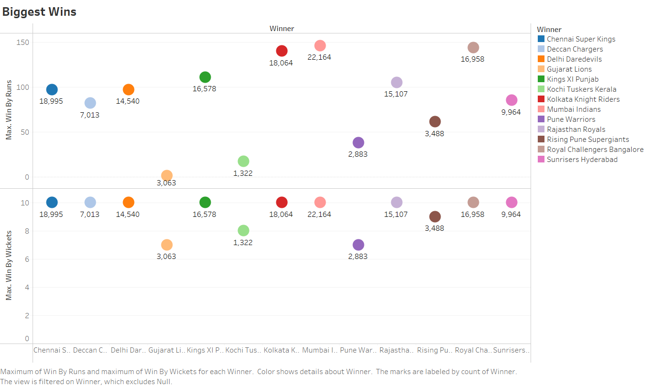
IPL Visualization Assignment
Biggest Wins

Slide 8
IPL Visualization Assignment
Biggest Wins
INSIGHTS
Mumbai Indian has the highest win by runs with 146 runs and has won (22164)maximum number of matches(Throughout the IPL).
Mumbai Indian, Royal Challengers Banglore and Kolkata Knight Riders are the TOP 3 teams to win by maximum runs – 146, 144 and 146 respectively
Majority of the Teams have won by 10 wickets.

Slide 9
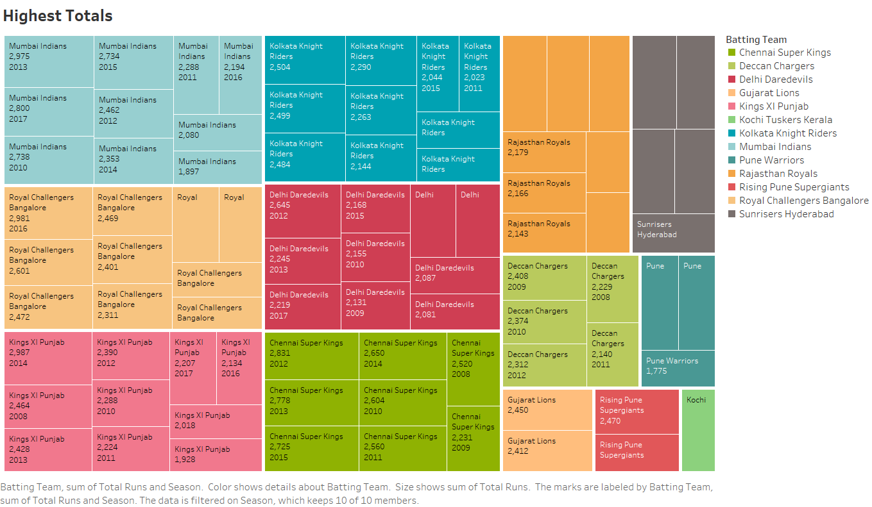
IPL Visualization Assignment
Highest Total

Slide 10
IPL Visualization Assignment
Highest Total
INSIGHTS
Kings XI Punjab has scored maximum total runs of 2987 through out the IPL.
Mumbai Indians, Royal Challengers Banglore and Kings XI Punjab are the top teams to score maximum runs through out the IPL seansons
Kochi Tuskers Kerala have played for 1 Season of IPL(2011)
Pune was introduced twice throughout the IPL as Pune Warriors (2011 – 2013) and Rising Pune Supergiants (2016-2017)

Slide 11
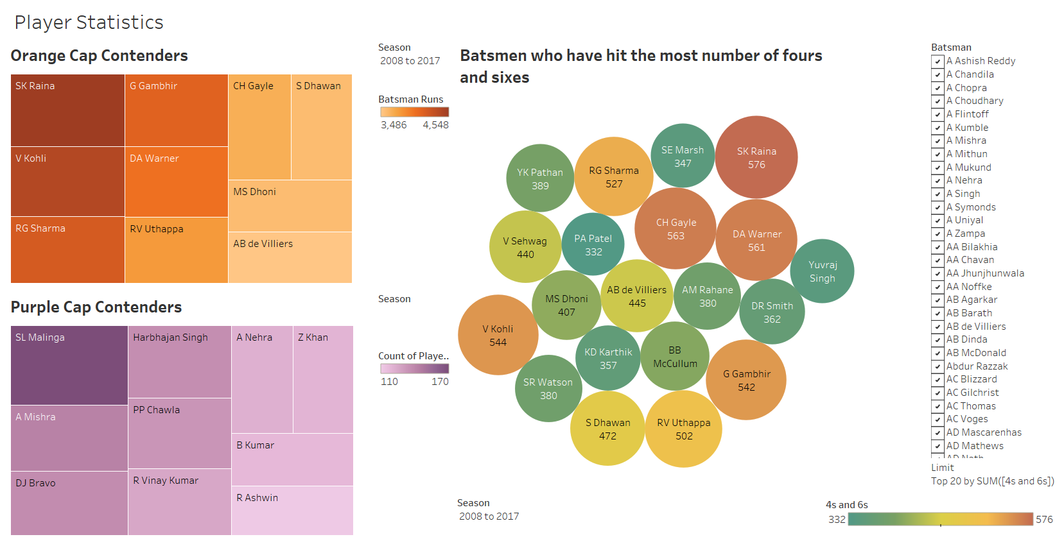
IPL Visualization Assignment
Dashboard 2 : Player Statistics

Slide 12
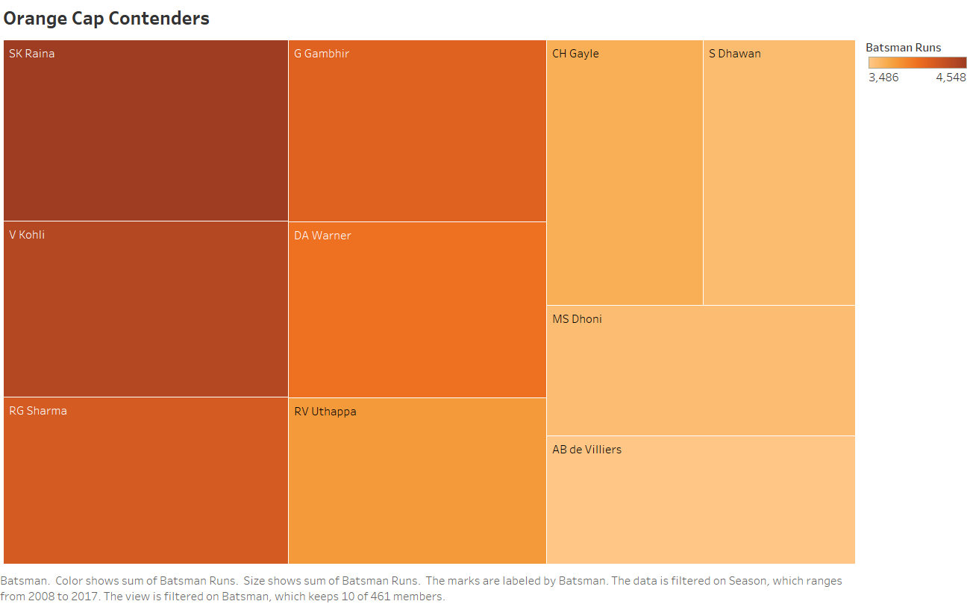
IPL Visualization Assignment
Orange Cap Contenders

Slide 13
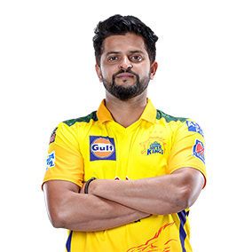
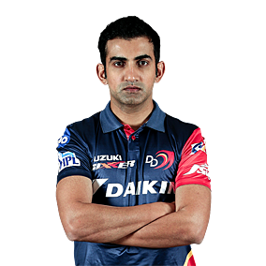
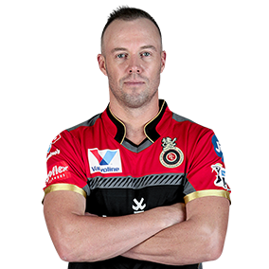
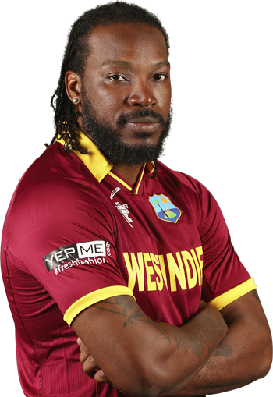
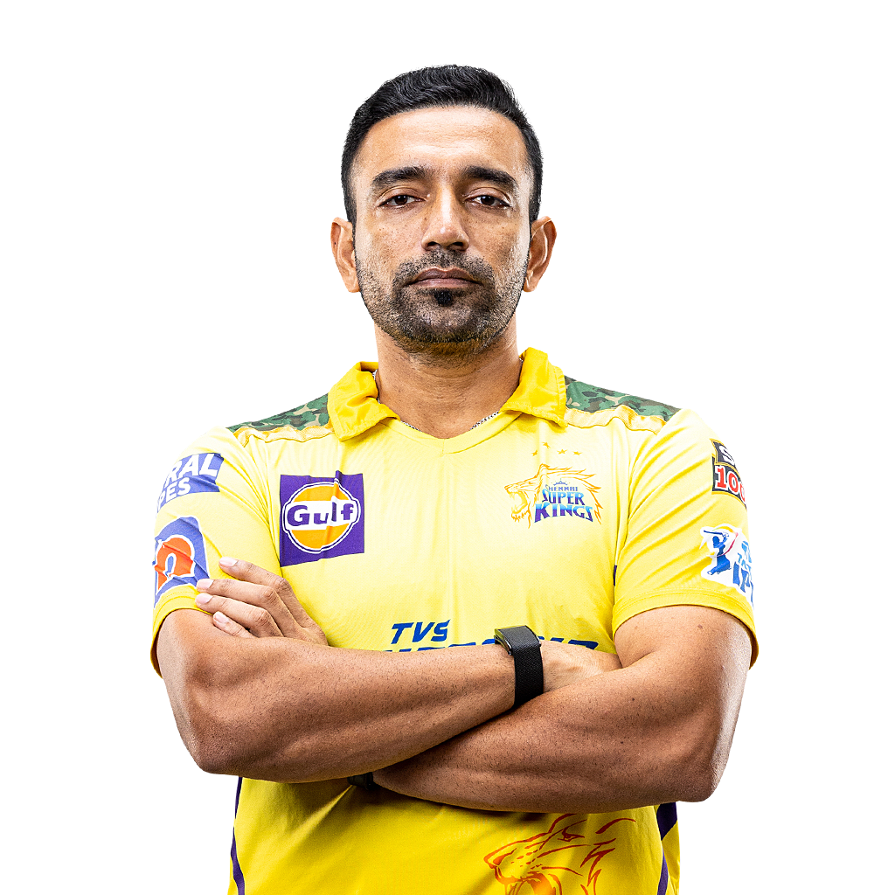

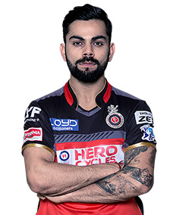
IPL Visualization Assignment
Orange Cap Contenders
INSIGHTS
SK Raina
(throughout the IPL)
SK Raina
(2008, 2010)
AB de Villers
(2009)
CH Gayle
(2011, 2012, 2013)
RV Uthappa
(2014)
DA Warner
(2015, 2017)
V Kohli
(2016)

Slide 14
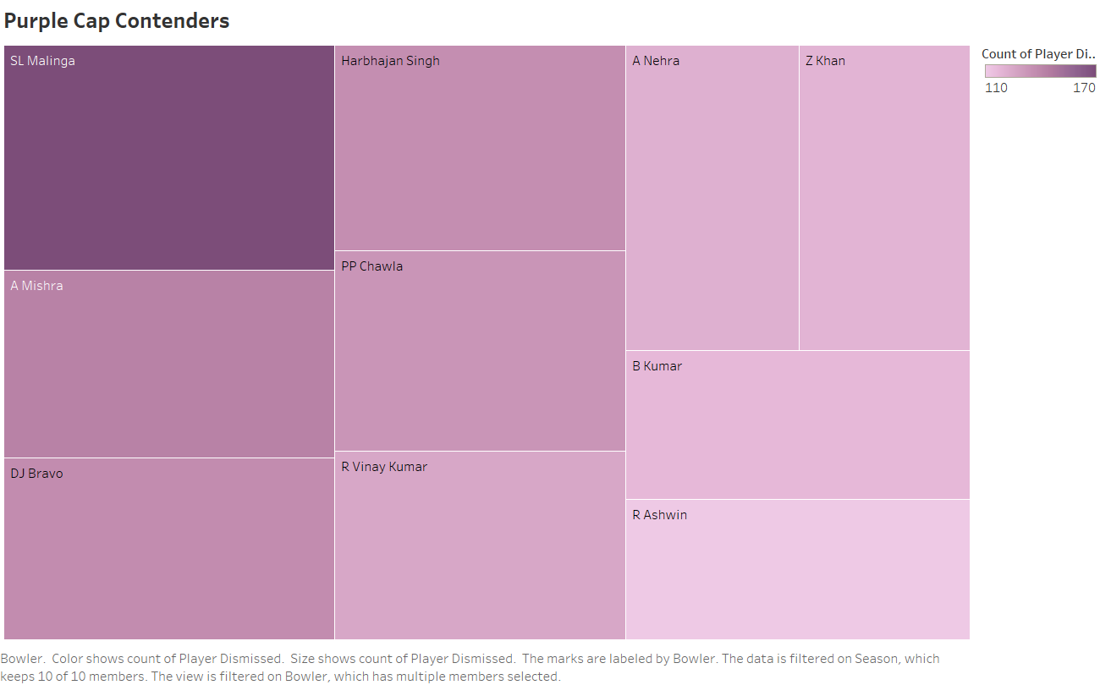
IPL Visualization Assignment
Purple Cap Contenders

Slide 15
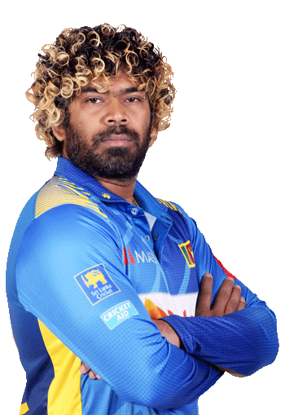
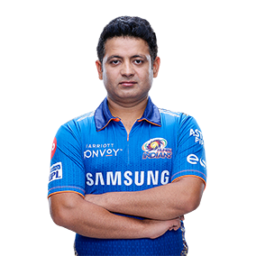
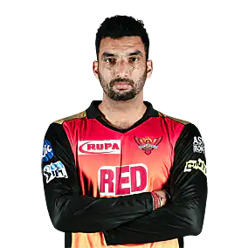
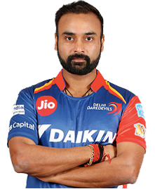
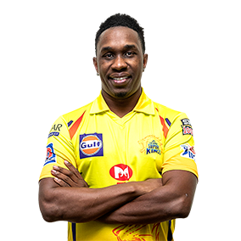
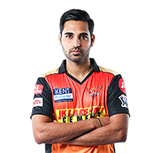
IPL Visualization Assignment
Purple Cap Contenders
INSIGHTS
SL Malinga
(throughout the IPL, 2011, 2012 )
PP Chawla
(2008)
A Nehra
(2009)
A Mishra
(2010)
DJ Bravo
(2013, 2015)
B Kumar
(2014, 2016, 2017)

Slide 16
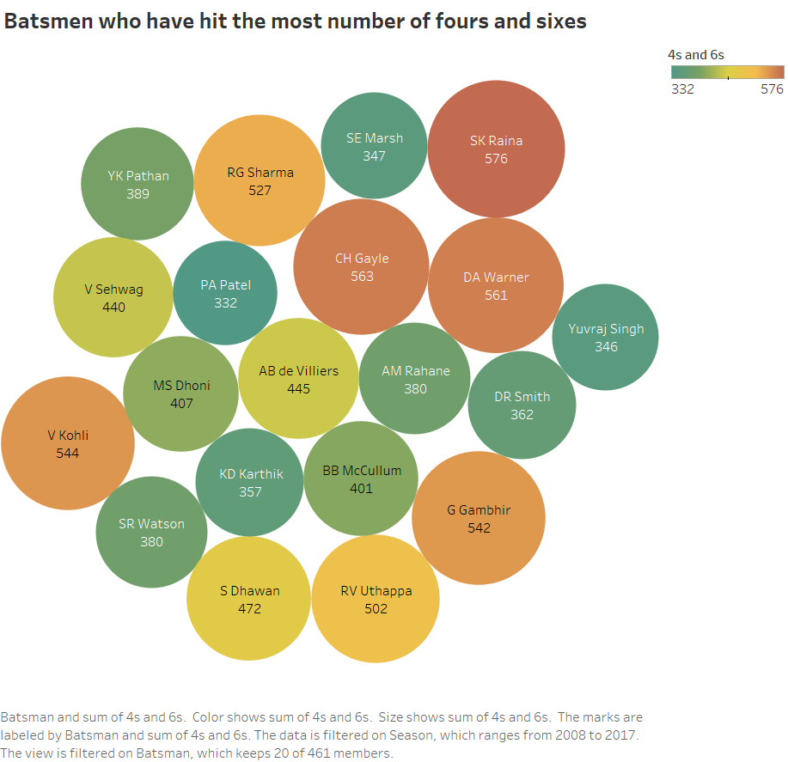
IPL Visualization Assignment
Most 4s & 6s
INSIGHTS
SK Raina has scored the maximum number of 4s & 6s
SK Raina, CH Gayle and DA Warner are the top 3 batsmen who have scored the most number of 4s and 6s

Slide 17
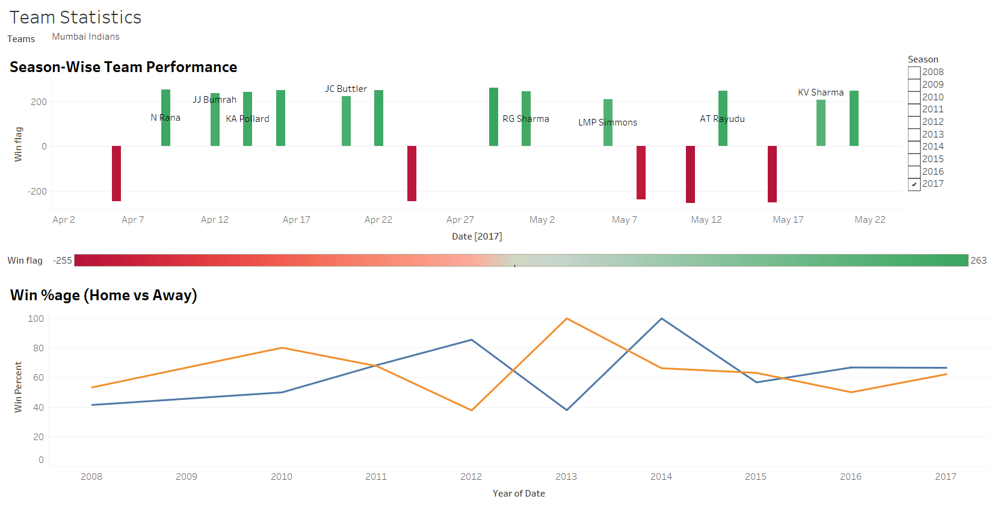
IPL Visualization Assignment
Dashboard 3 : TeamStatistics

Slide 18
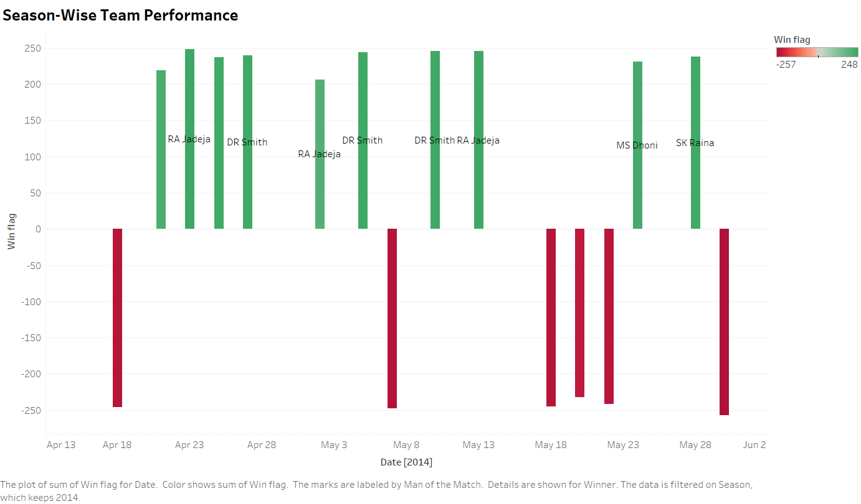
IPL Visualization Assignment
Season-wise Team Performance

Slide 19
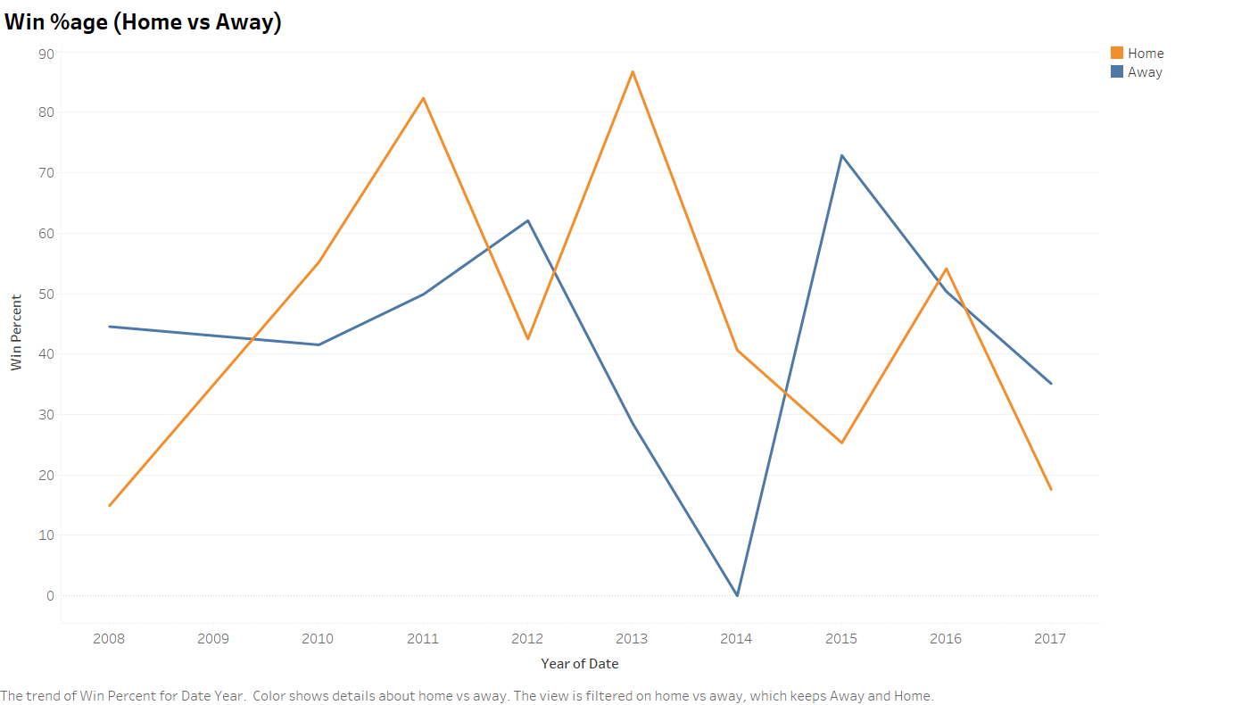
IPL Visualization Assignment
Win %age(Home Vs Away)

